Slide 1

Adjoint Inverse Designed Metasurfaces with Visible Multiwavelength Steering
2021. 7. 7
백웅재, 김휘
일리노이 대학교
고려대학교
INTEGRATED
PHOTONIC
DEVICES&
SYSTEMS LAB

Slide 2
Contents
INTEGRATED
PHOTONIC
DEVICES&
SYSTEMS LAB
Introduction (Metagrating)
Adjoint Inverse Design
Topology Optimization Method
Simulation Result
Conclusion (GSS & Robustness)

Slide 3
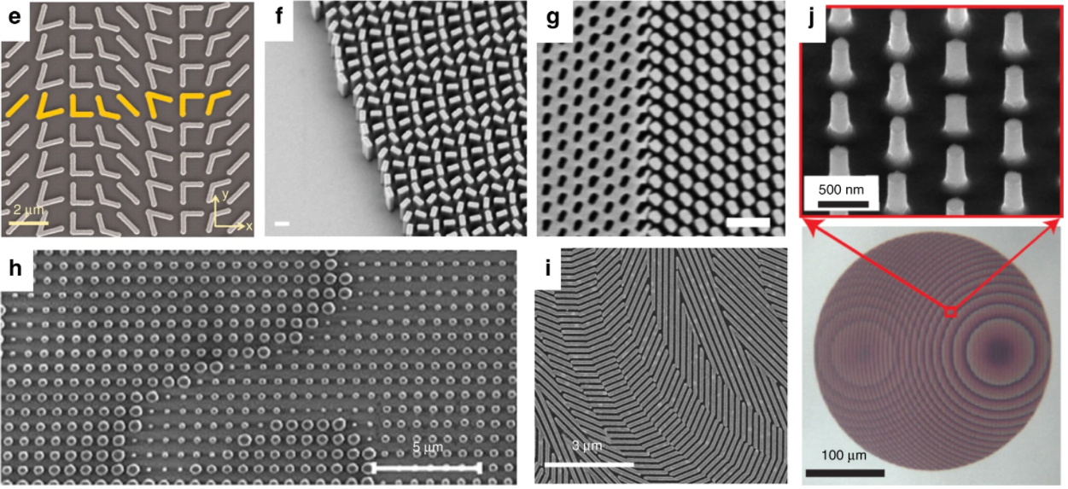
Introduction
Metagrating
Effective Medium
Conventional Way: Implement regularly spaced
nanowaveguides or nanoresonators
75%
What is the most effective way for producing a metasurface
with a desired phase profile?
Transmit Array
40%
Echelle
10%
Geometric Phase
30%
Neshev, D., Aharonovich, I. Light Sci Appl 7, 58 (2018)

Slide 4
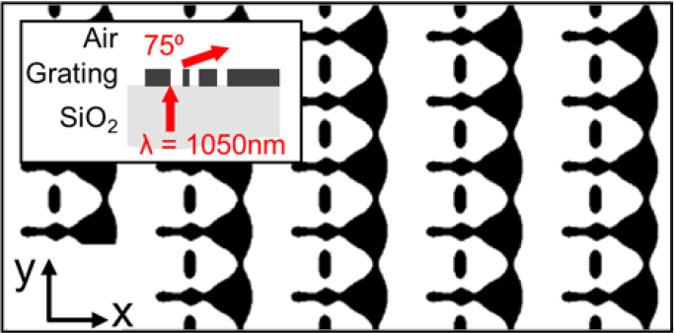
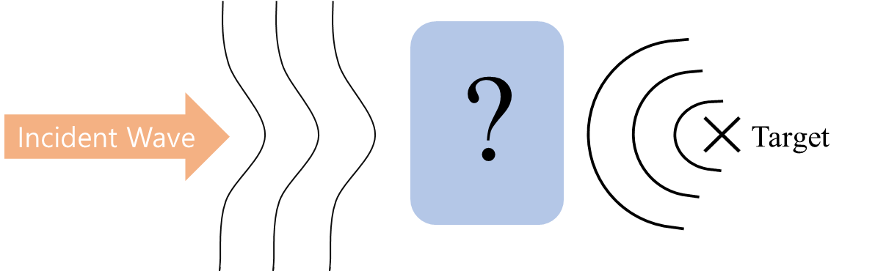
Adjoint Inverse Design
Inverse Design Concept
State-of-the-art example
Grating Purpose: Diffraction to target order
Air
Grating
Substrate
Jonathan Fan, Nano Lett. (2017)
Visible Light
SiO2

Slide 5
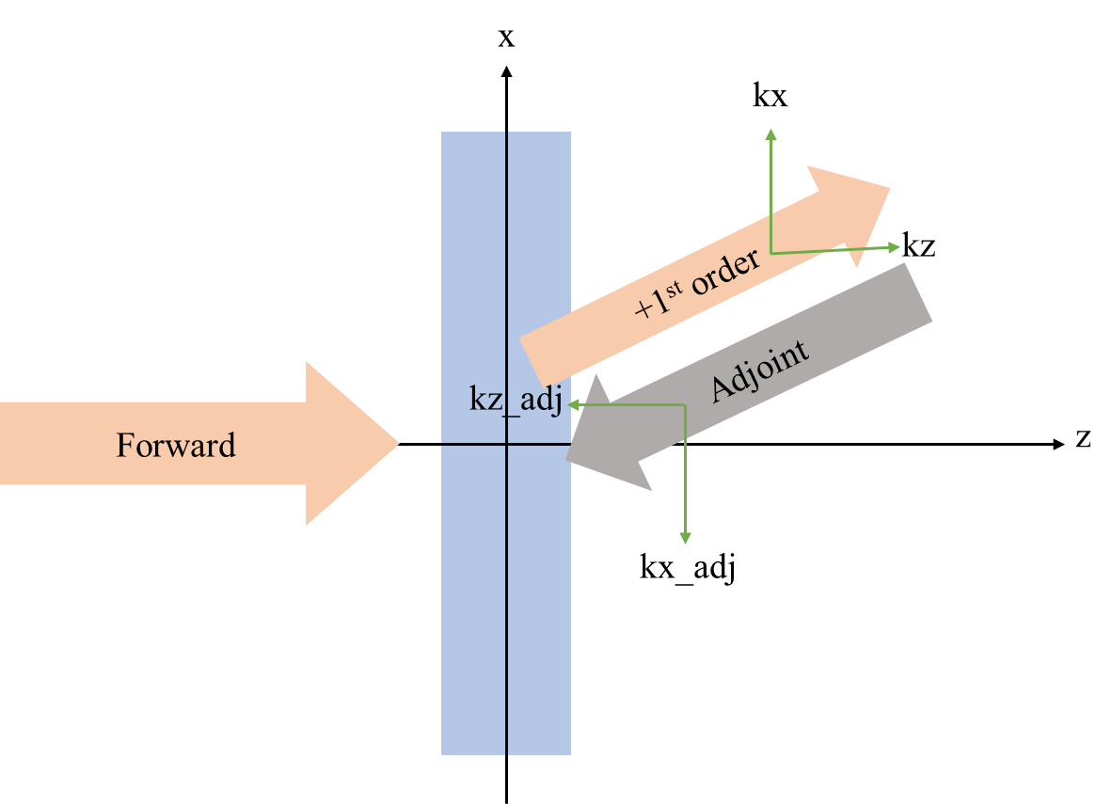
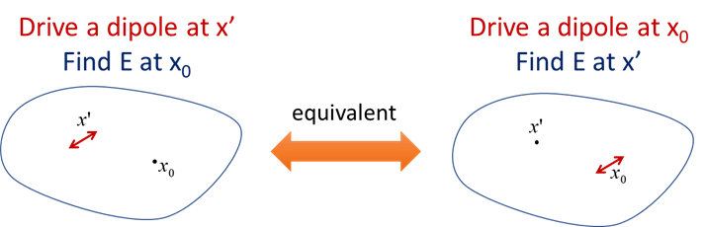
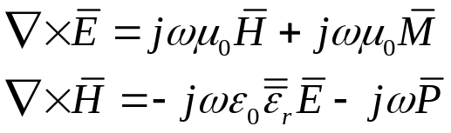
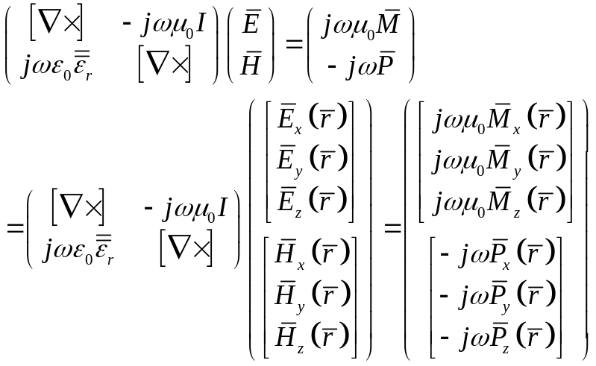
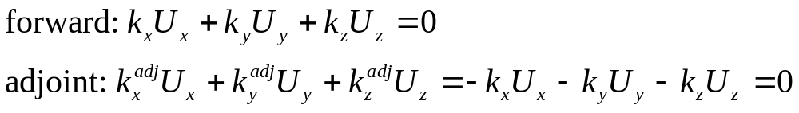
Adjoint Inverse Design
Adjoint Inverse Design Theory
Vector Wave Equation
Lorentz Reciprocity
Discretization
Optimization Target

Slide 6
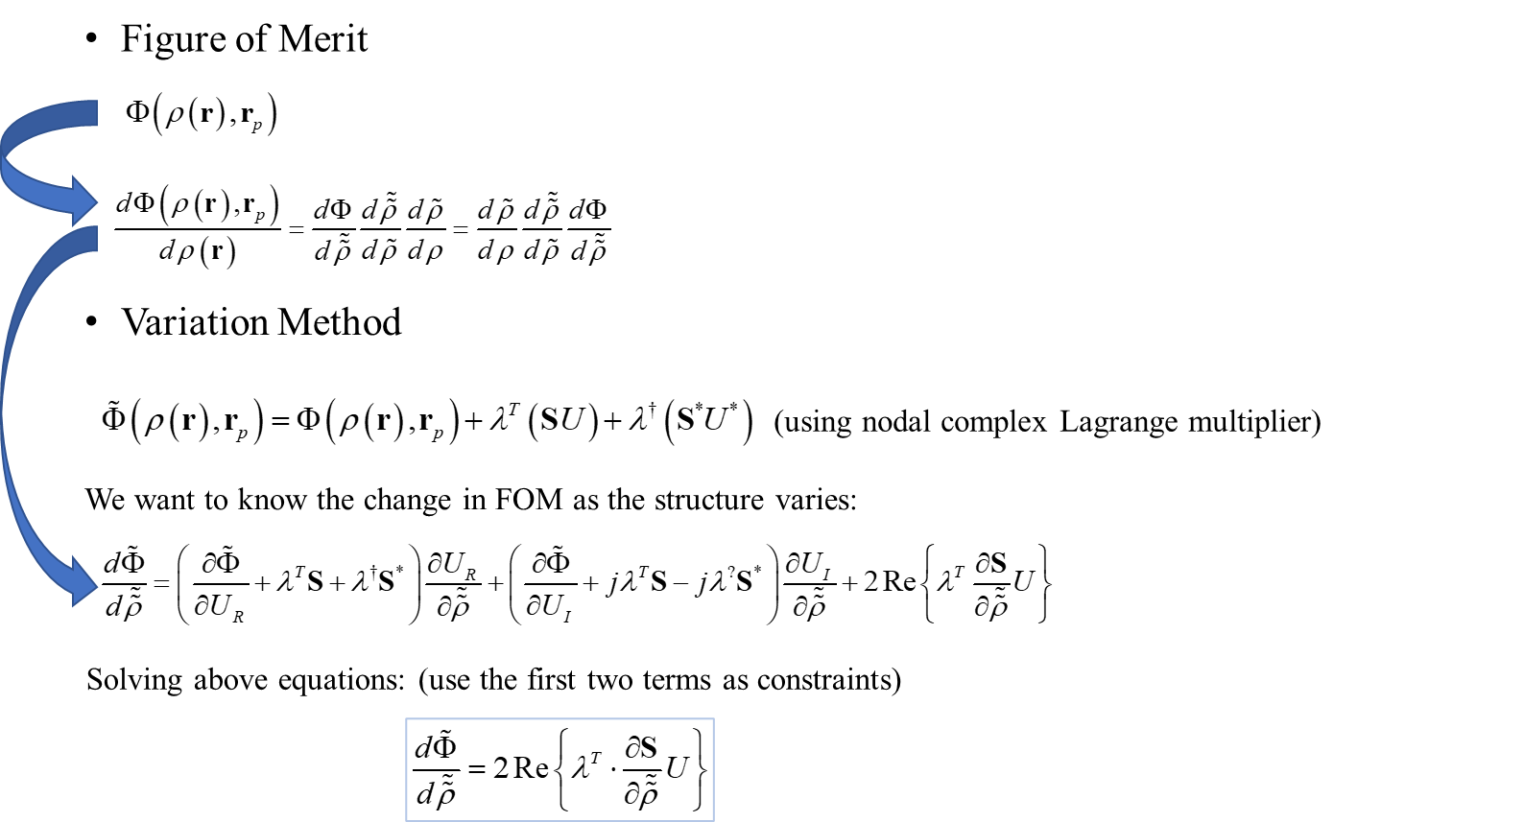
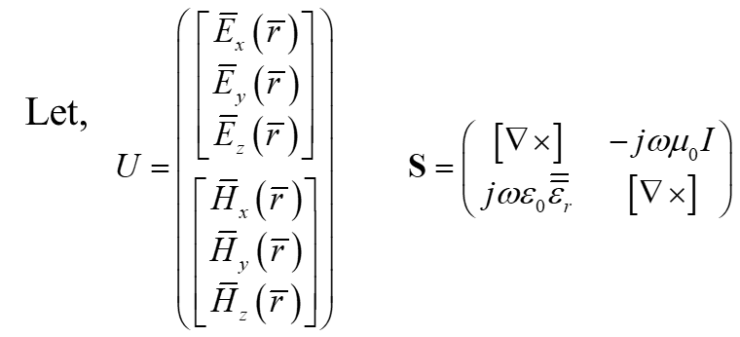
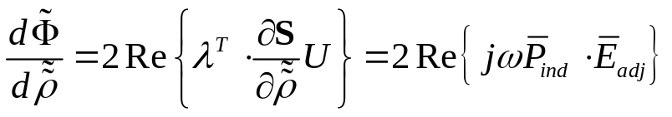

Adjoint Inverse Design
Adjoint Inverse Design Theory

Slide 7
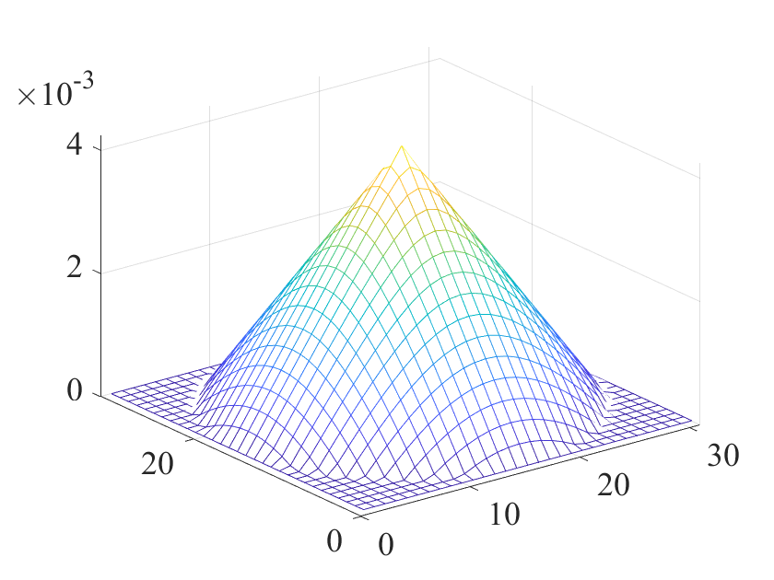
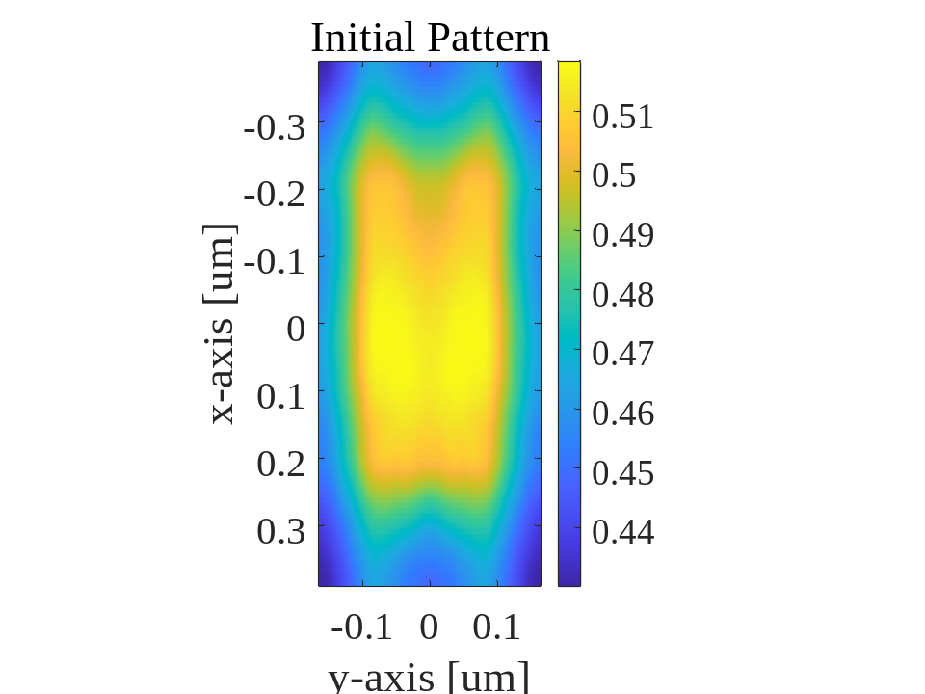
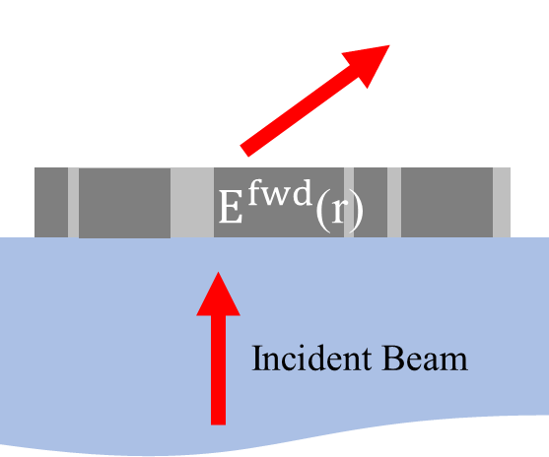
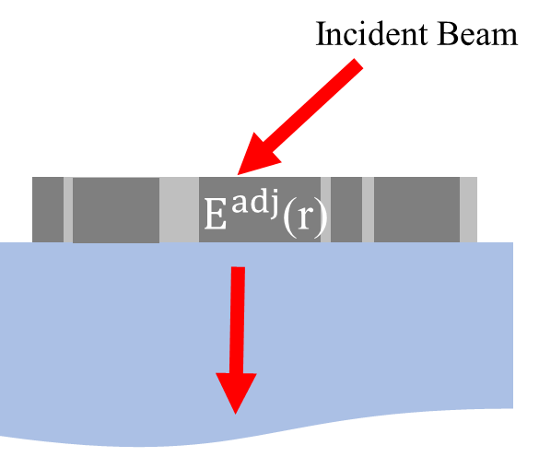


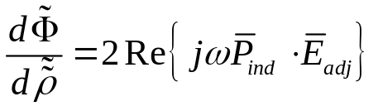



Topology Optimization Method
Meta-Optics Inverse Design Framework
For each iteration,
the forward and adjoint simulations are:
Gaussian Filter
Random permittivity profile
(Gaussian Blurred for clustering)
Forward Simulation
Adjoint Simulation
Iteration m
Iteration m+1
$$ρ_{1}$$
ADAM
$$ρ_{m}$$
${ρ_{m+1}=ρ}_{m}$+$\frac{∂Φ}{∂ρ}$

Slide 8
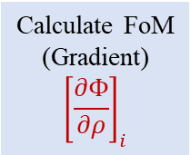

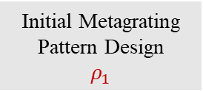


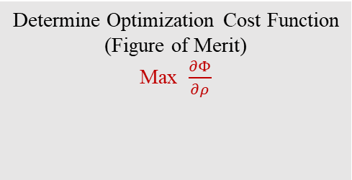
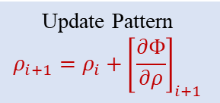
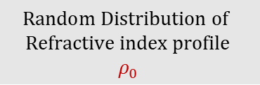
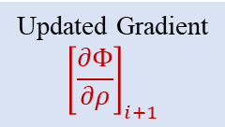
Topology Optimization Method
Design Flow Chart
Optimization Begins
Simulation Verification
1) Field Visualization
2) Efficiency Calculation
3) Processable Structure Check
$$Random Distribution of$$
$$Refractive index profile$$
$$ρ_{0}$$
Final Meta-Design
$$ρ_{final}$$
Yes
Clustering by
Gaussian Blurring
Meet Criterion?
Enforce
Symmetry
Update Pattern
$${ρ_{i+1}=ρ_{i}+\left[\frac{∂Φ}{∂ρ}\right]}_{i+1}$$
Updated Gradient
$${\left[\frac{∂Φ}{∂ρ}\right]}_{i+1}$$
Initial Metagrating
Pattern Design
$$ρ_{1}$$
Initial Binarization
Binarization
Enforce
Symmetry
Enforce Symmetry
No
Gaussian
Blurring
Optimization Loop
i=1$⋯$ m
ADAM
Determine Optimization Cost Function
(Figure of Merit)
Max $\frac{∂Φ}{∂ρ}$
Calculate FoM
(Gradient)
$${\left[\frac{∂Φ}{∂ρ}\right]}_{i}$$
Updating Pattern
$$ρ_{i}$$
FMM
Forward
Simulator
FMM
Adjoint
Simulator

Slide 9
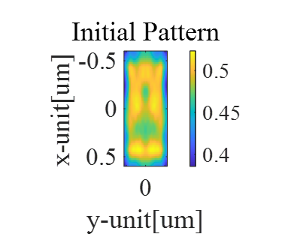
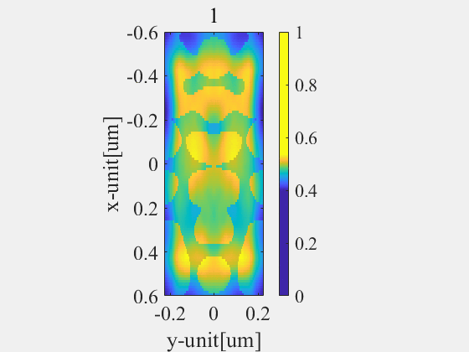
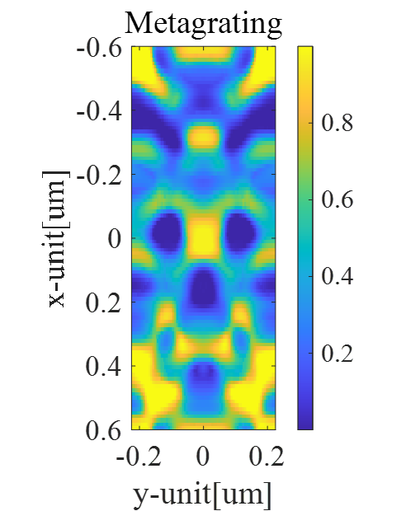
Simulated Results
Topology Optimization
After 200 epoch

Slide 10
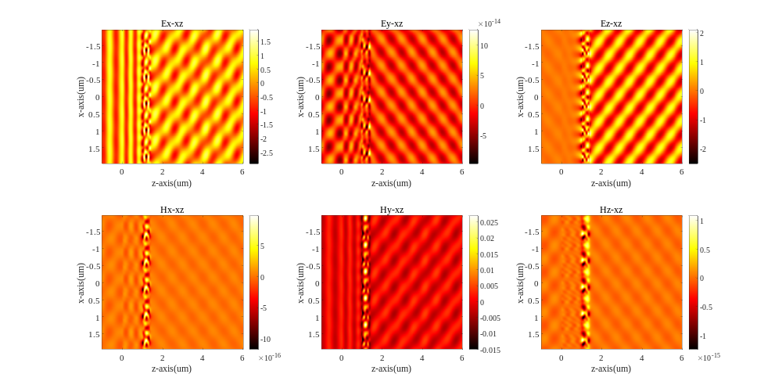
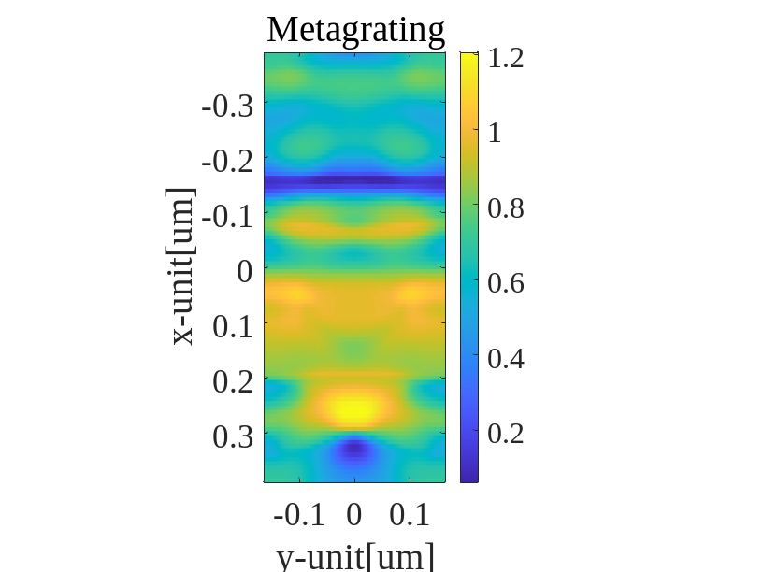
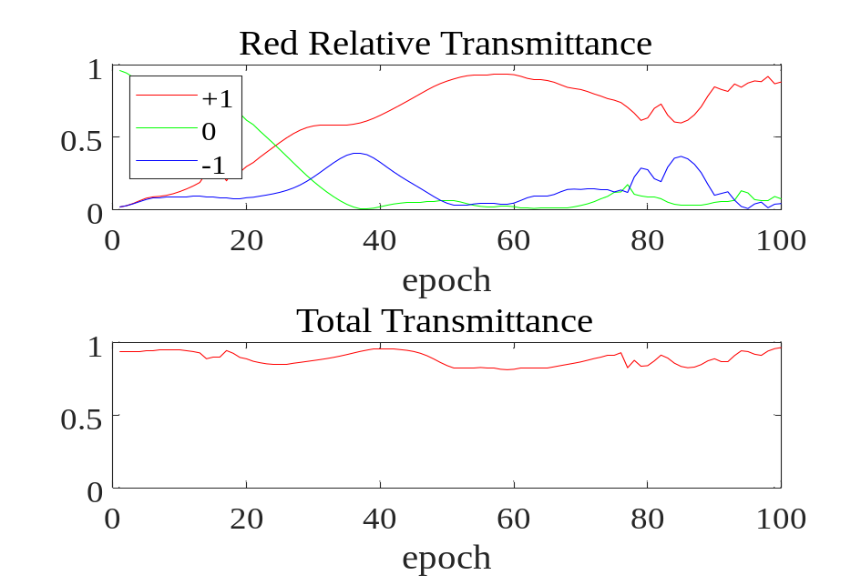
Simulated Results
Topology Optimization
Red (620nm)
Absolute Transmittance: 85.1%
Target Diffraction Order: +1 st
Diffracted Angle: 52.6 (deg)
Simulation parameter
Tx = 780nm
Ty = 330nm
Number of sampling = 101×101
Polarization mode = TM
Substrate = 1um(SiO2)
Grating = 400nm(c-Si)

Slide 11
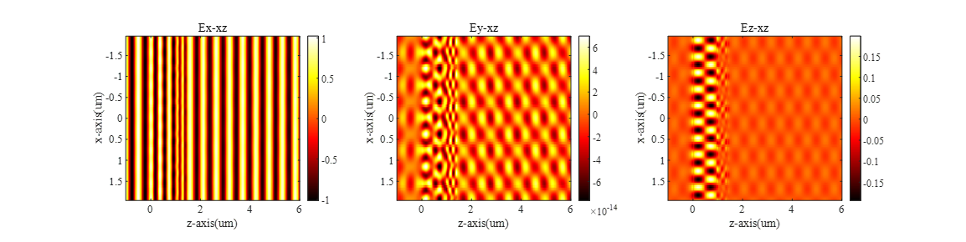
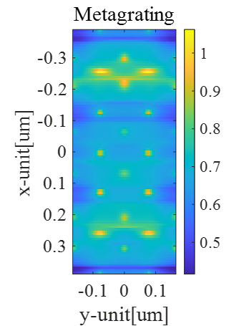
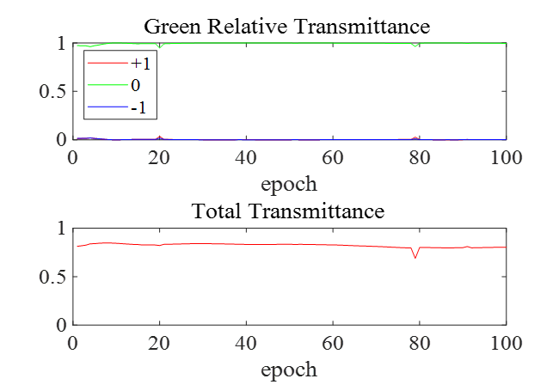
Simulated Results
Topology Optimization
Green (532nm)
Absolute Transmittance: 80.0%
Target Diffraction Order: 0 (DC)
Diffracted Angle: 0 (deg)
Simulation parameter
Tx = 780nm
Ty = 330nm
Number of sampling = 101×101
Polarization mode = TM
Substrate = 1um(SiO2)
Grating = 400nm(c-Si)

Slide 12
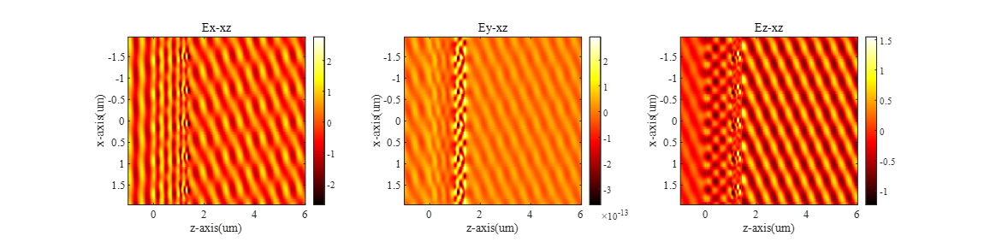
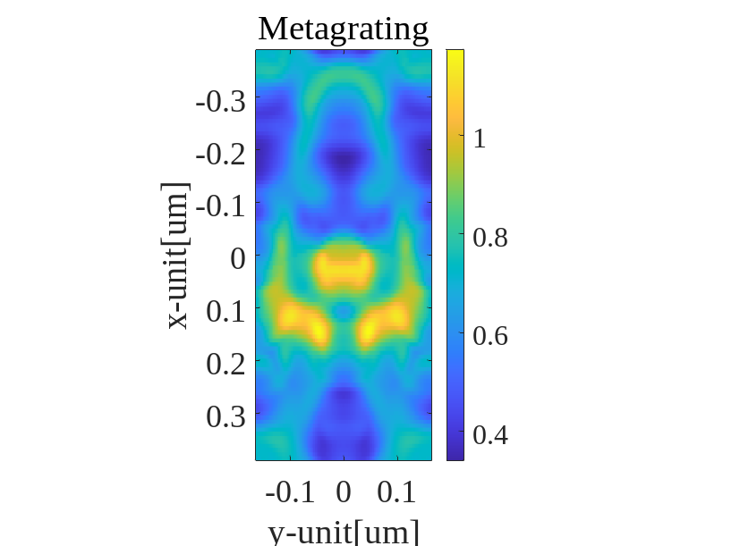
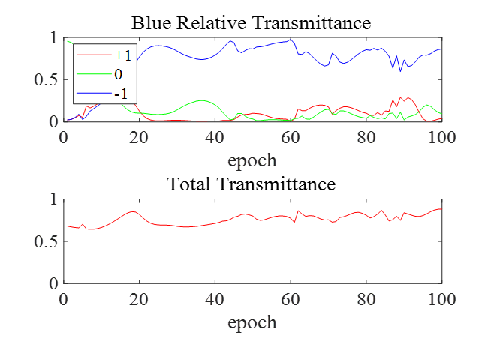
Simulated Results
Topology Optimization
Blue (473nm)
Absolute Transmittance: 76.2%
Target Diffraction Order: -1st
Diffracted Angle: 37.3 (deg)
Simulation parameter
Tx = 780nm
Ty = 330nm
Number of sampling = 101×101
Polarization mode = TM
Substrate = 1um(SiO2)
Grating = 400nm(c-Si)

Slide 13
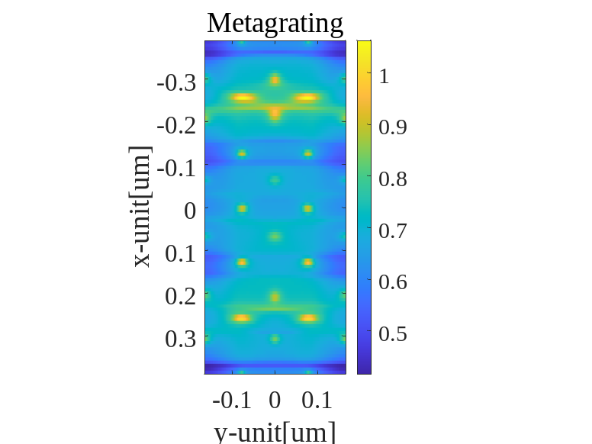
Simulated Results
Topology Optimization
Beam Splitter
Beam Combiner
0th
0th
Red
Green
Blue
-1st
-1st
+1st
+1st
330 nm
780 nm
Deflected beam
Incident beam
(White)

Slide 14
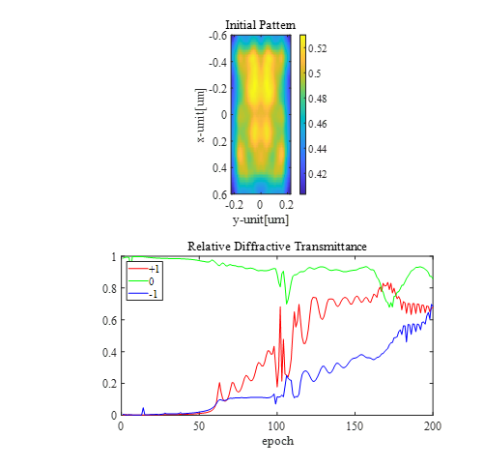
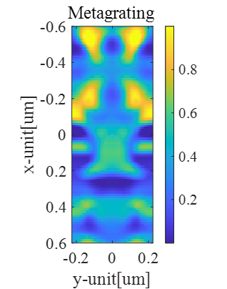
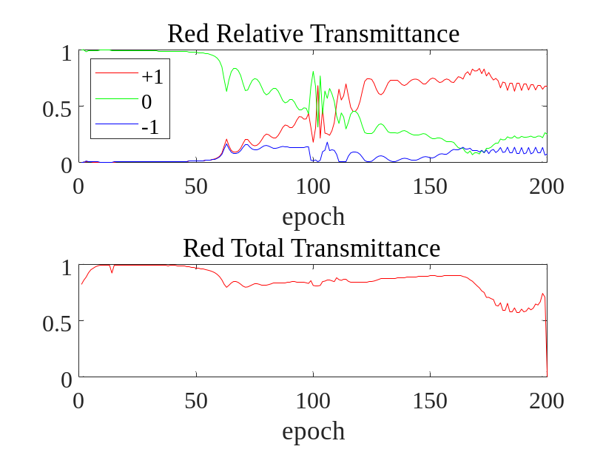
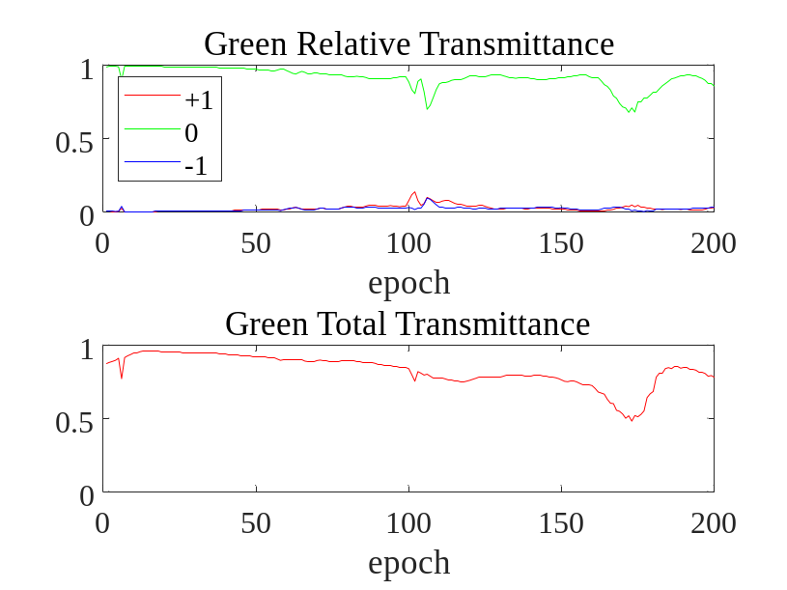
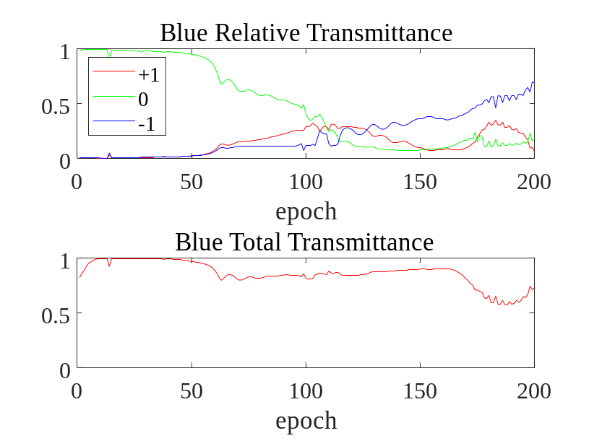
Simulated Results
Topology Optimized Result
Simulation parameter
Tx = 1200nm
Ty = 450nm
Number of sampling = 101×101
Polarization mode = TM
Substrate = 1um(SiO2)
Grating = 400nm(c-Si)

Slide 15
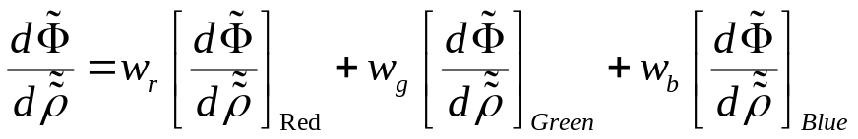
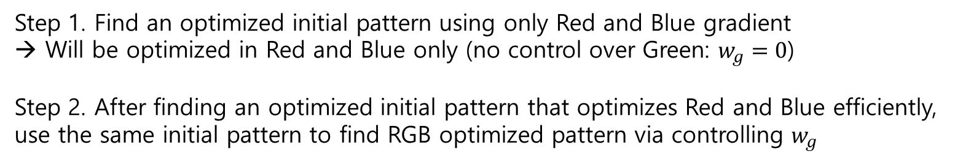
Simulated Results
Additional Optimization Routine
Step 1. Find an optimized initial pattern using only Red and Blue gradient
→ Will be optimized in Red and Blue only (no control over Green: $w_{g}=0$)
Step 2. After finding an optimized initial pattern that optimizes Red and Blue efficiently,
use the same initial pattern to find RGB optimized pattern via controlling $w_{g}$

Slide 16
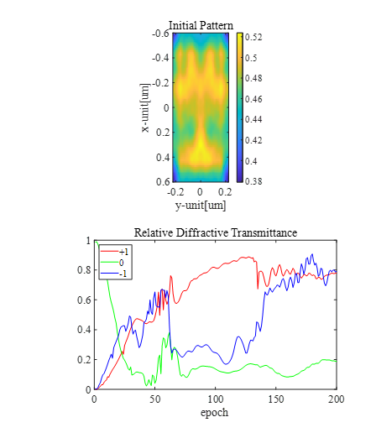
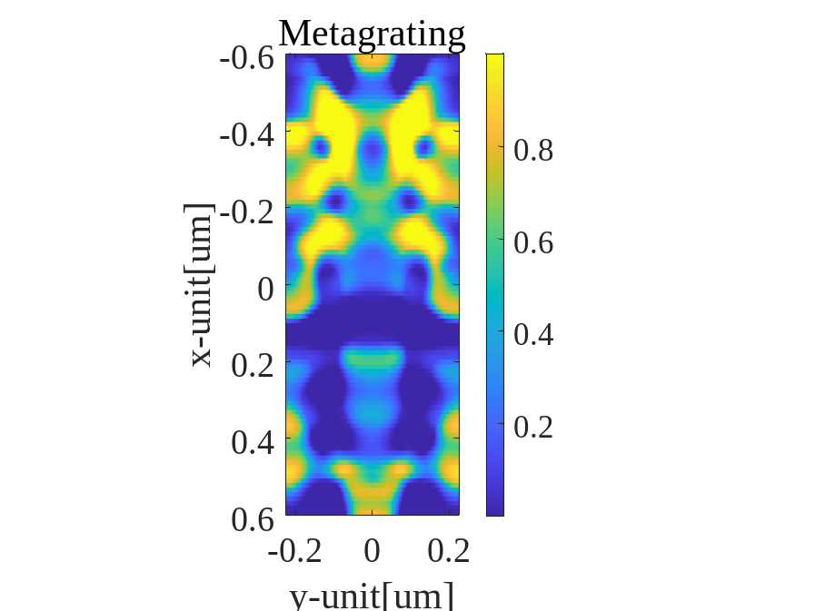
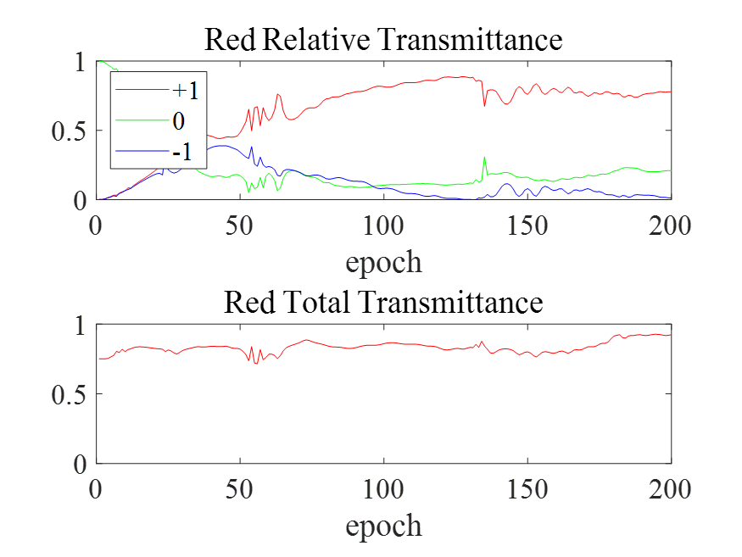
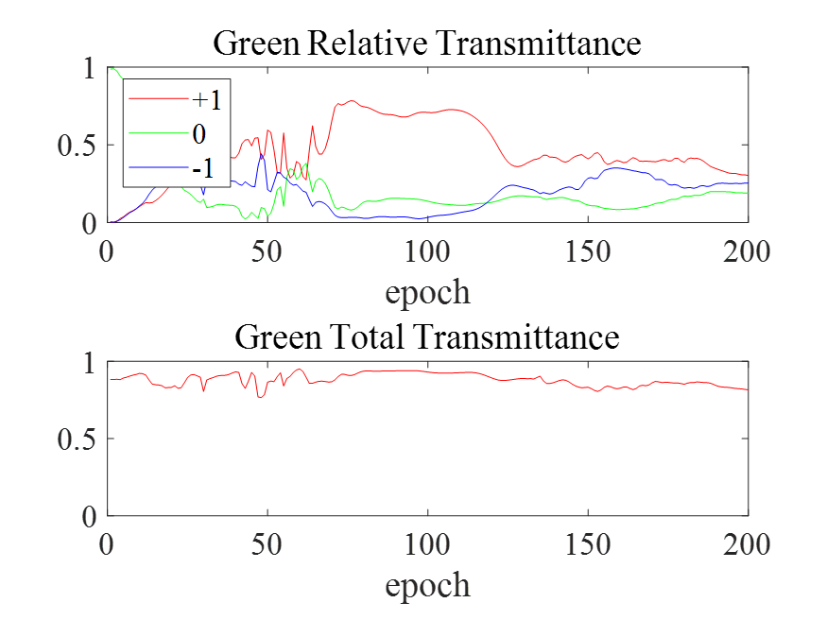
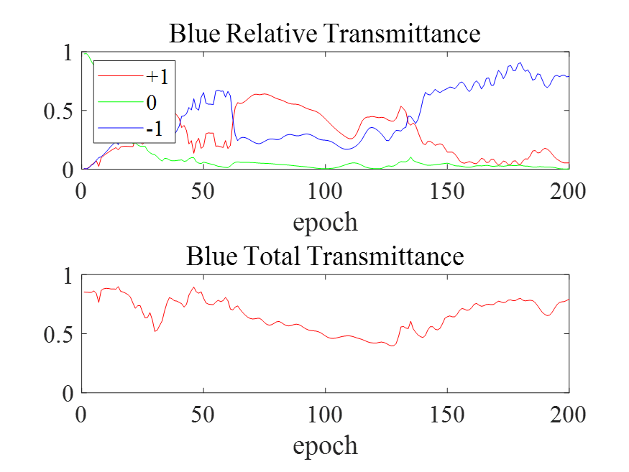
Simulated Results
Step 1 Result
Simulation parameter
Tx = 1200nm
Ty = 450nm
Number of sampling = 101×101
Polarization mode = TM
Substrate = 1um(SiO2)
Grating = 400nm(c-Si)

Slide 17
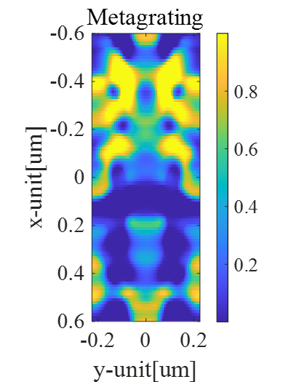
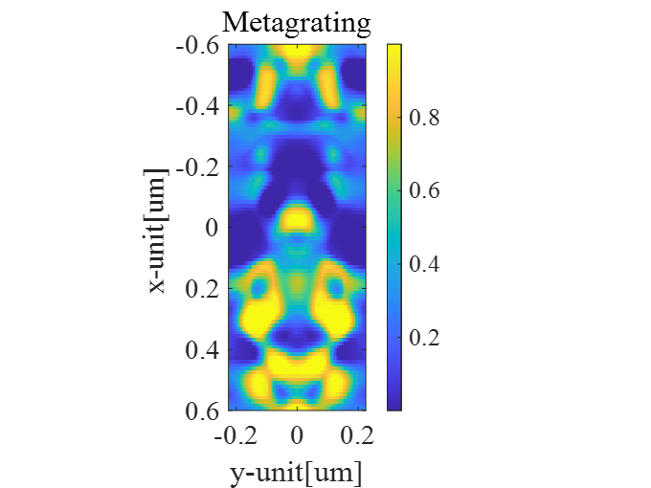
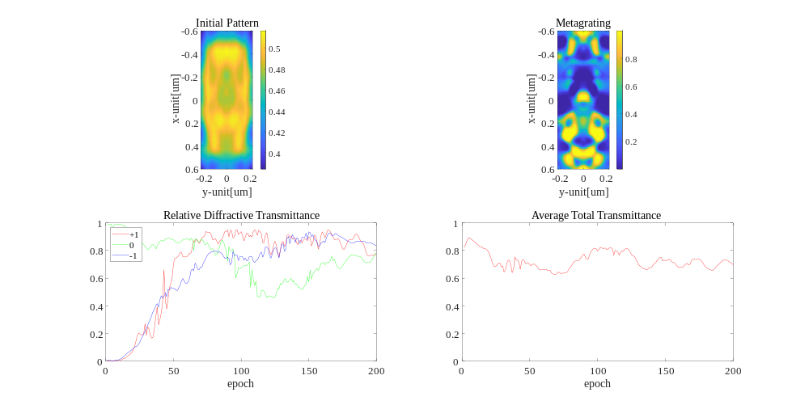



Simulated Results
Step 2 Result
Simulation parameter
Tx = 1200nm
Ty = 450nm
Number of sampling = 101×101
Polarization mode = TM
Substrate = 1um(SiO2)
Grating = 400nm(c-Si)

Slide 18






Simulated Results
Simulated Structure Field Visualization
Red
Green
Blue
Forward
Adjoint

Slide 19




Simulated Results
Simulated Structure Field Visualization
Red
Incident
Green
Incident
Blue
Incident
Blue
R/G/B
Green
Red

Slide 20




Conclusion
Summary
Adjoint Inverse Design Theory
R/G/B Steering Metagratings Design
Multiwavelength Steering Metagrating in one layer
Further reducing computational cost via additional algorithm
Future Works
Finding processable structure by adopting appropriate binarization and gaussian blurring
Enhanced optimization: Golden Section Search

Slide 21
Thank you for your attention

Slide 22

Appendix
Types of metasurface and its efficiency
Effective Medium
Transmit Array
Echelle
Geometric Phase

Slide 23



Appendix
Scalar Fourier Modal Method
Step 1: Slicing region of interest & Stair-case approximation
Step 2: Eigenmode analysis for each layer
Step 3: Boundary conditions & Scattering Matrix
Step 4: S-matrix method for interconnecting multi-block structures

Slide 24


Discretized Variational Form based Adjoint Inverse Design Theory
INTEGRATED
PHOTONIC
DEVICES&
SYSTEMS LAB
Discretization
We can discretize the electric and magnetic field into N number of local fields
Vector Wave Equation
Discretization
Let,

Slide 25



Discretized Variational Form based Adjoint Inverse Design Theory
INTEGRATED
PHOTONIC
DEVICES&
SYSTEMS LAB
Figure of Merit
Variation Method
(using nodal complex Lagrange multiplier)
We want to know the change in FOM as the structure varies:
Solving above equations: (use the first two terms as constraints)

Slide 26






Discretized Variational Form based Adjoint Inverse Design Theory
INTEGRATED
PHOTONIC
DEVICES&
SYSTEMS LAB
Solving Lagrange Multiplier
Source terms

Slide 27


Discretized Variational Form based Adjoint Inverse Design Theory
INTEGRATED
PHOTONIC
DEVICES&
SYSTEMS LAB
Calculating Sensitivity

Slide 28


Optimization Problem
light input

Slide 29

Where should I add material?
light input
light input
light input
…
Need to know dF/dx’ for all x’

Slide 30
What happens when I add material?
Original
Perturbation = small sphere of material
E_{perturbed}
E₀
ε₁
ε₁
ε₂
P

Slide 31



How can I approximate this perturbation?
E_{perturbed}
E₀
E_{scattered}
≈
+

Slide 32
Key Trick 1: (approximate every perturbation as a dipole scatterer)
…
+
…
+

Slide 33
Reciprocity (Rayleigh-Carson)
Drive a dipole at x’
Find E at x₀
Drive a dipole at x₀
Find E at x’
equivalent

Slide 34
Reciprocity (Lorentz)
Problem: Solve for E₁ and E₂
Dual Problem: Solve for E₃
E₃(x’’)
J₁(x’)
E₃(x’)
E₁
J₃
equivalent
J₁ • E₃ = J₃ • E₁
J₂(x’’)
E₂
J₂ • E₃ = J₃ • E₂

Slide 35
Key Trick 2: (Lorentz reciprocity)
…
+
+

